Slide 1
NORTHWIND DATA ANALYSIS

Slide 2
OVERVIEW
Northwind is a fictional business specializing in a variety of products, including Beverages, Condiments, Confections, Dairy Products, Cereals, Meat, Produce, and Seafood. The dataset includes files such as Categories, Customer Details, Employee Details, Order Details, Orders, and Products. Questions were provided to query the dataset

Slide 3

TOOL USED

Slide 4
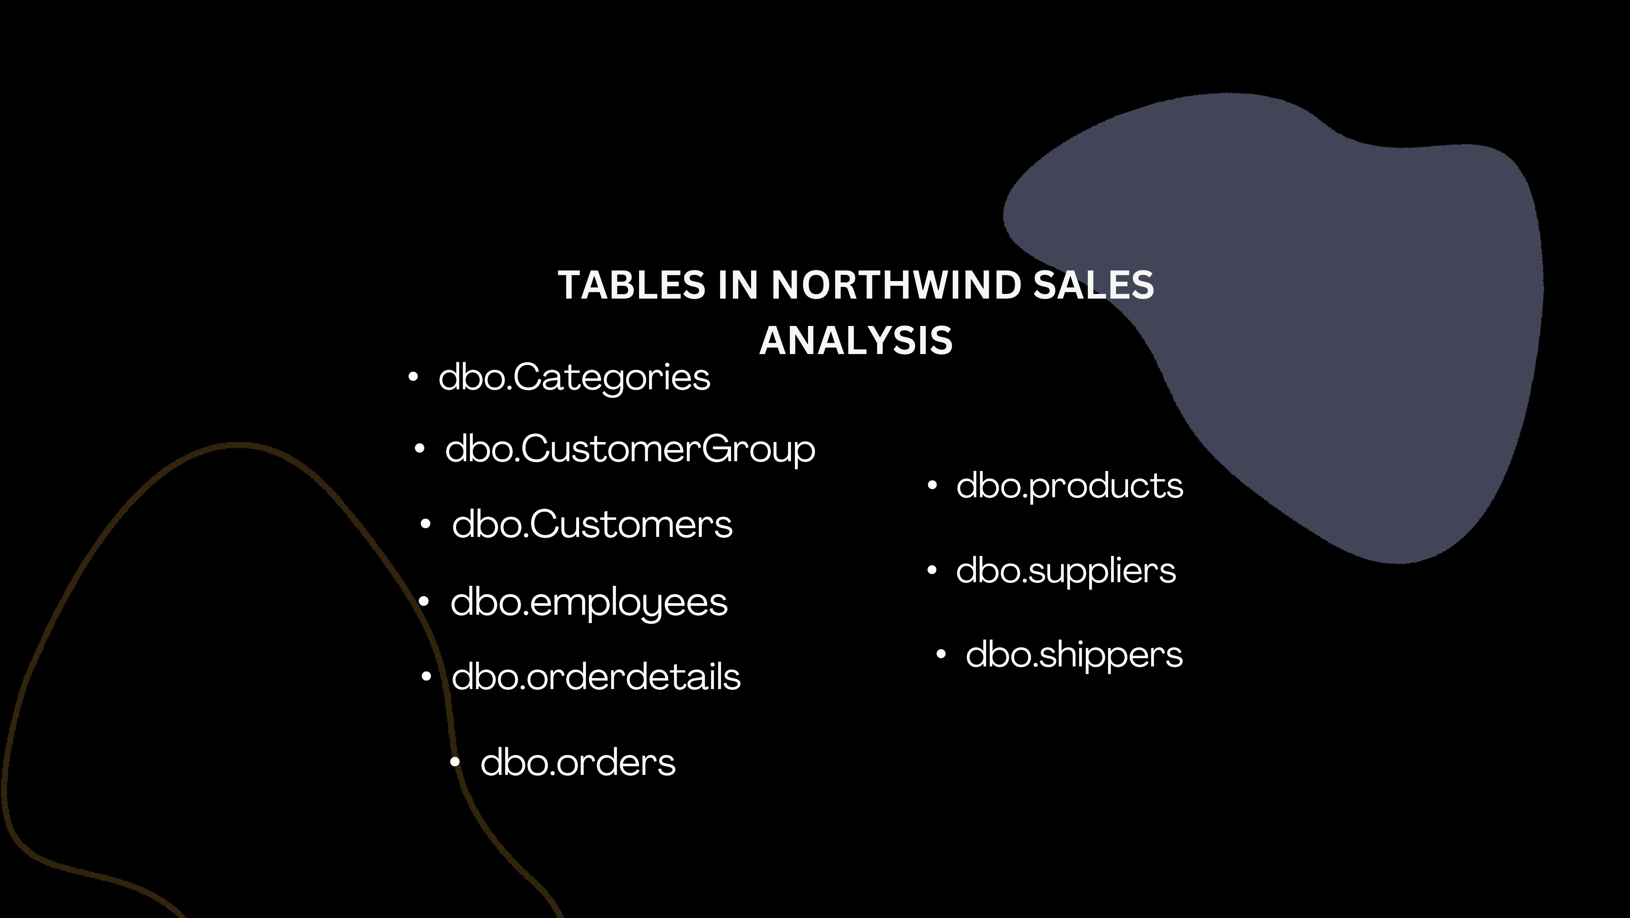

Slide 5
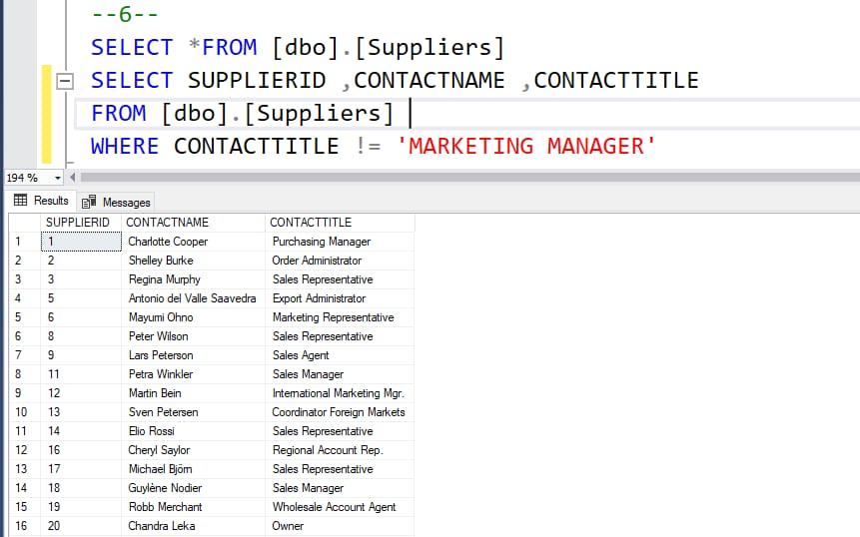
In the Suppliers table, show the SupplierID, ContactName, and ContactTitle for those Suppliers whose ContactTitle is not Marketing Manager

Slide 6
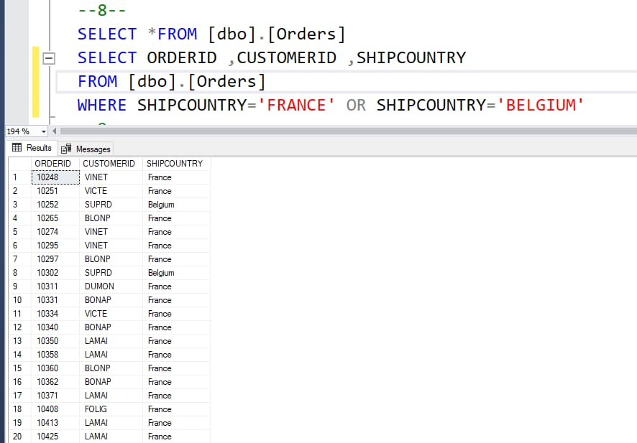
Orders shipping to France or Belgium

Slide 7
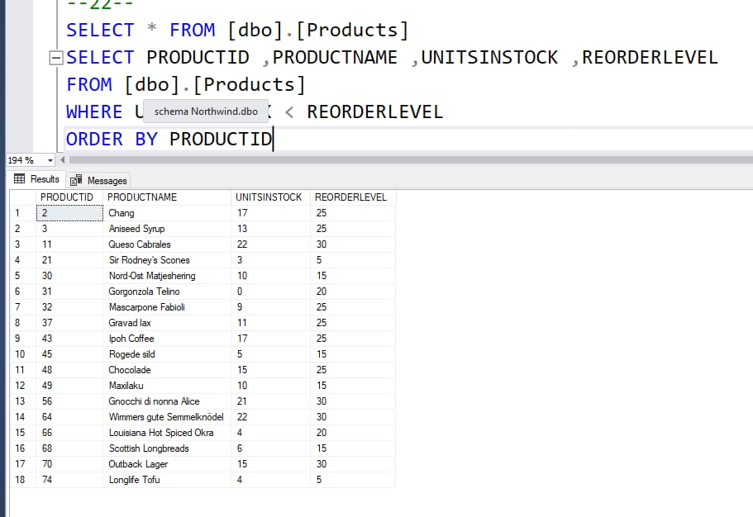
Products that need reordering

Slide 8
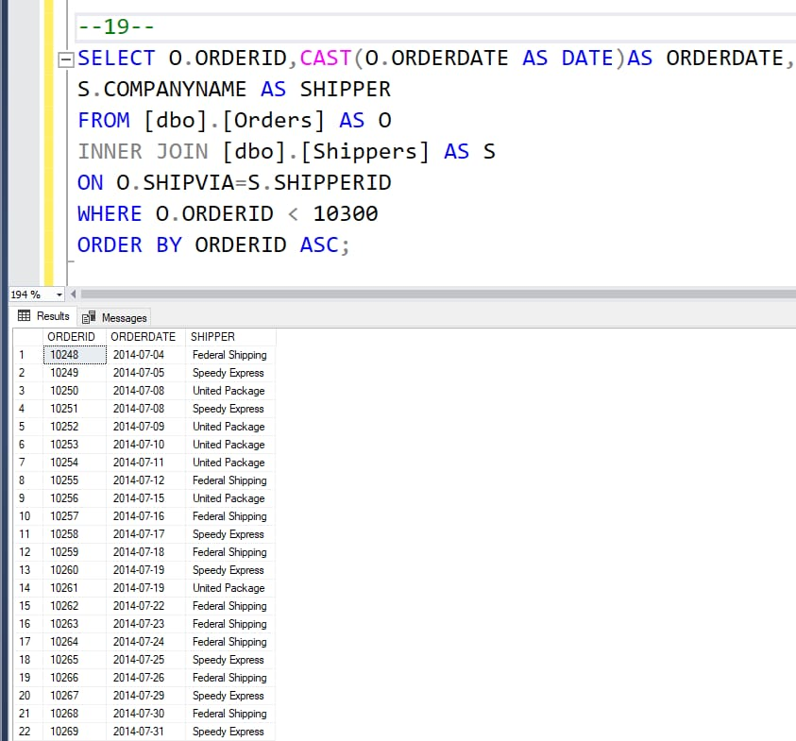
how the OrderID, OrderDate (date only), and CompanyName of the Shipper, and sort by OrderID.

Slide 9
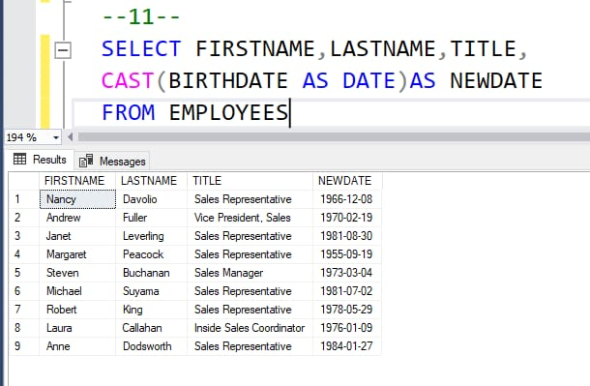
showing the Employees in order of BirthDate, we see the time of the BirthDate field, which we don’t want. Show only the date portion of the BirthDate field.

Slide 10
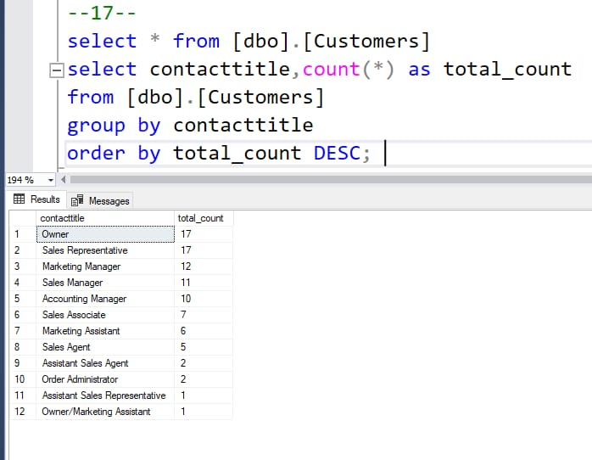
Show a list of all the different values in the Customers table for ContactTitles. Also include a count for each ContactTitle.

Slide 11
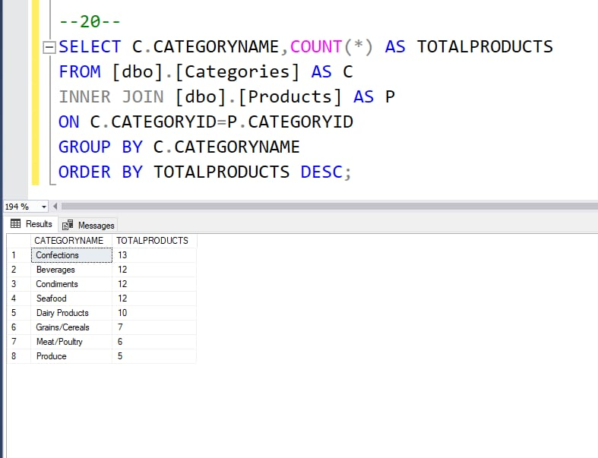
the total number of products in each category. Sort the results by the total number of products, in descending order.

Slide 12
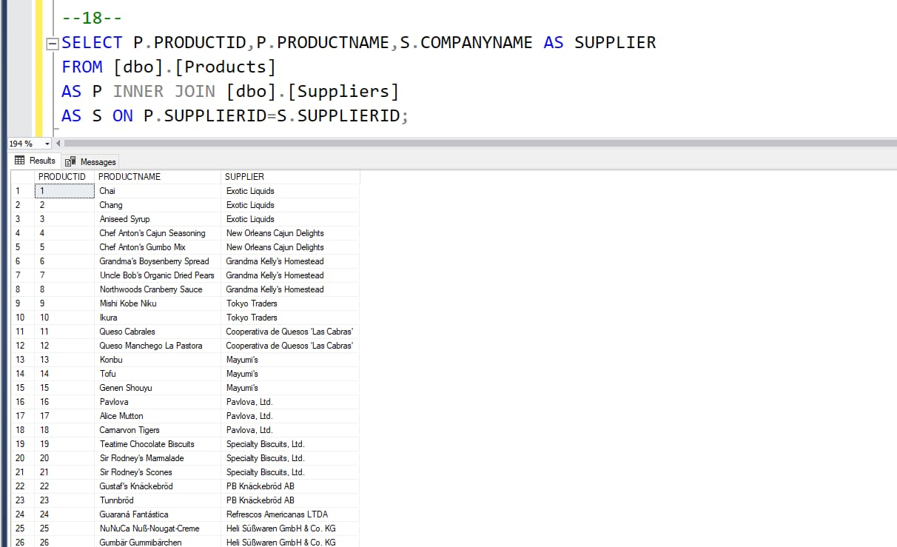
For each product, the associated Supplier. Show the ProductID, ProductName, and the CompanyName of the Supplier. Sort by ProductID.
This question will introduce what may be a new concept, the J

Slide 13
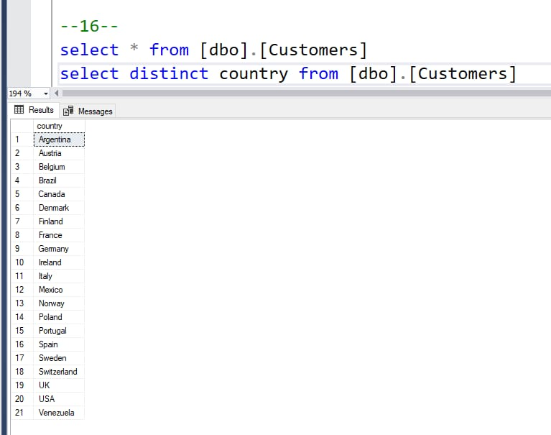
Countries where there are customers

Slide 14
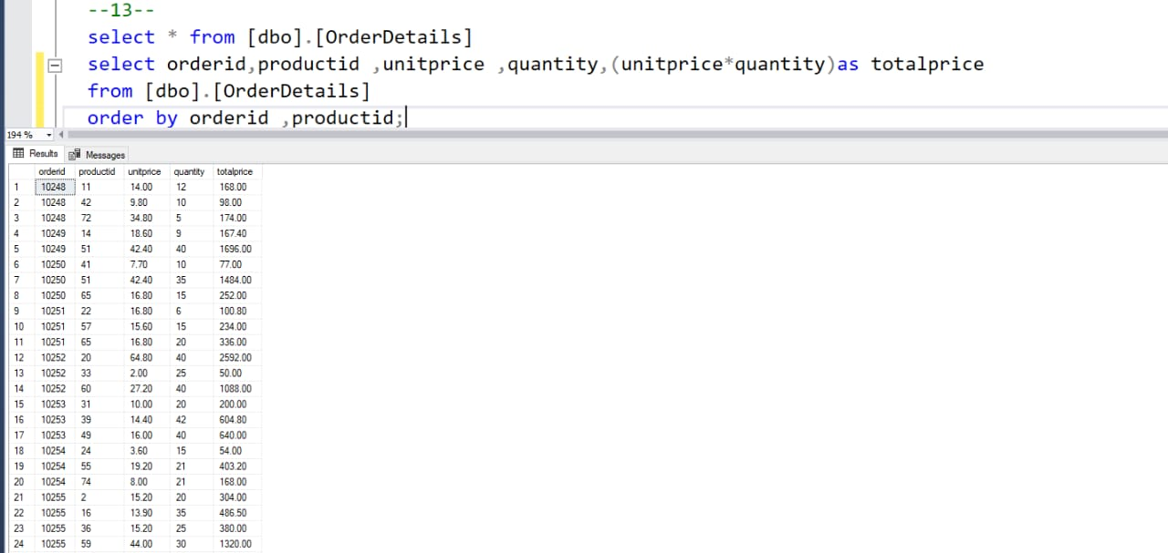
Create a new field, TotalPrice, that multiplies these two together.

Slide 15
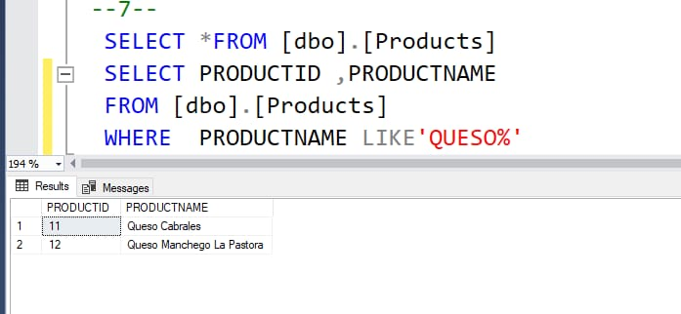
he ProductID and ProductName for those products where the ProductName includes the string “queso”.

Slide 16
THANK YOU
Prepared by NIKHITHA J GADAD

